Slide 1
Assessment of Stair Ascend/Descend Speed
About this deck
Prepared by: Narayanan Ramesh as a response for a task to estimate speed of an individual ascending or descending stairs

Slide 2
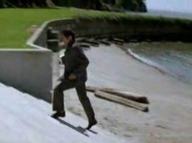
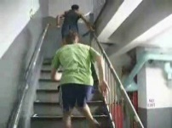
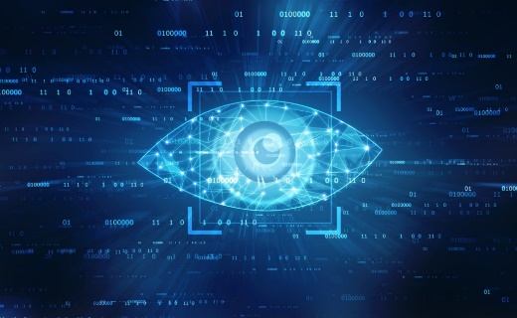
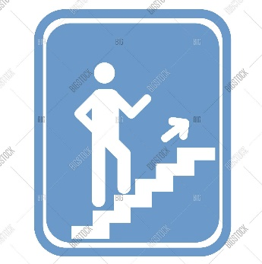
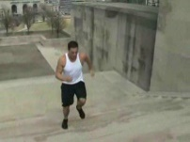
Overview
INPUT
PROCESS
OUTPUT
.MP4
Computer Vision
Climbing Speed
.MP4
.
.
.
Machine Learning
(steps/second) (metre/second)
.MP4

Slide 3
Data Selection
HMDB Database – 112 clips in climb_stairs action class
Easy of availability and downloading capability
File names provided details regarding visible body parts, camera viewpoint, number of people involved, video quality etc.
Stabilized video files

Slide 4
Data Selection
HMDB Database – 112 clips in climb_stairs action class
Easy of availability and downloading capability
File names provided details regarding visible body parts, camera viewpoint, number of people involved, video quality etc.
Stabilized video files

Slide 5
Data Selection
HMDB Database – 112 clips in climb_stairs action class
Easy of availability and downloading capability
File names provided details regarding visible body parts, camera viewpoint, number of people involved, video quality etc.
Stabilized video files

Slide 6
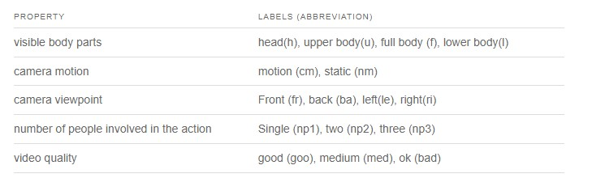
Data Selection
Fig: Label annotations for files in HMDB database

Slide 7
Data Selection
HMDB Database – 112 clips in climb_stairs action class
Easy of availability and downloading capability
File names provided details regarding visible body parts, camera viewpoint, number of people involved, video quality etc.
Stabilized video files

Slide 8
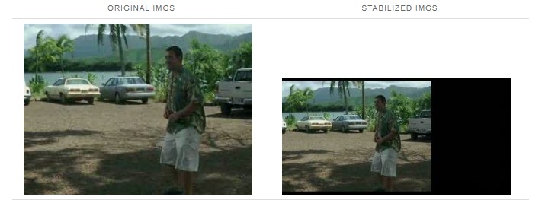
Data Selection
Fig: Frames from a stabilized video file

Slide 9
Thought process and ML approach
Estimating the number of steps climbed by an actor
Research on detecting human and pose estimation – Mediapipe and OpenPose
By assuming height and depth of each stair, and timestamp of video – Speed can be computed
Where can machine learning fit in ?

Slide 10
Thought process and ML approach
Estimating the number of steps climbed by an actor
Research on detecting human and pose estimation – Mediapipe and OpenPose
By assuming height and depth of each stair, and timestamp of video – Speed can be computed
Where can machine learning fit in ?

Slide 11
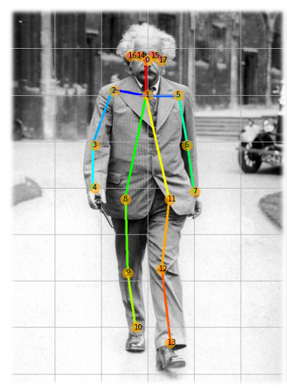
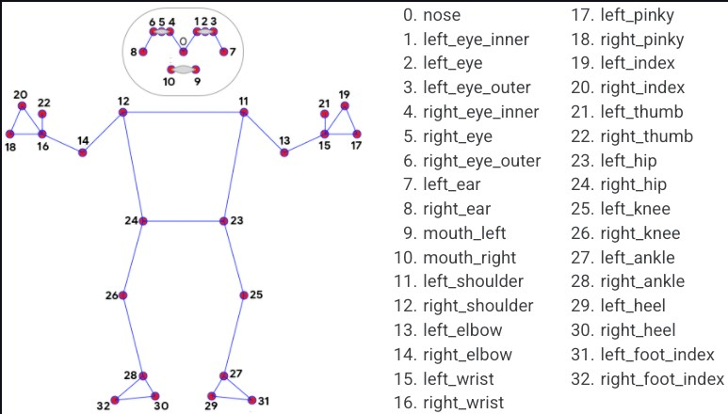
Thought process and ML approach
Fig: Pose estimation of a human image
Fig: Media pipe pose estimation landmarks

Slide 12
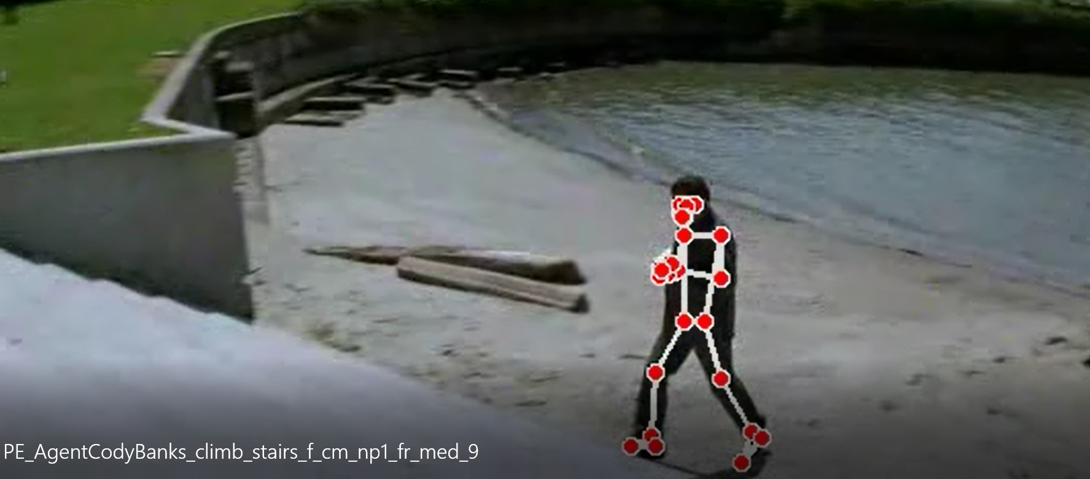
Thought process and ML approach
The distance between the foot (ankles) increases and decrease for each step the actor takes

Slide 13
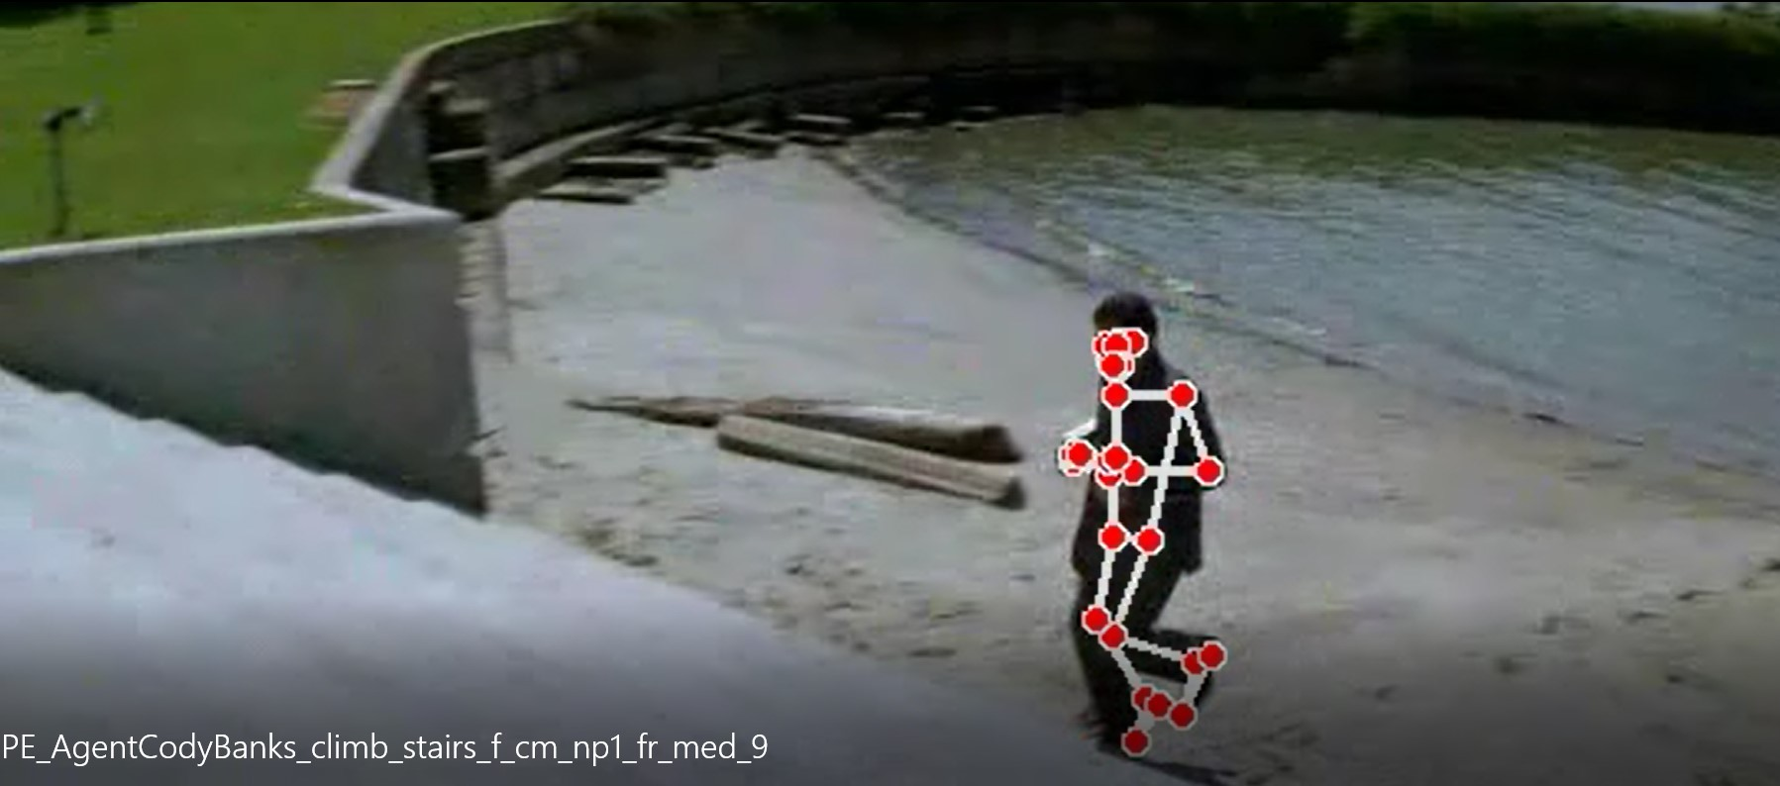
Thought process and ML approach
The distance between the foot (ankles) increases and decrease for each step the actor takes

Slide 14
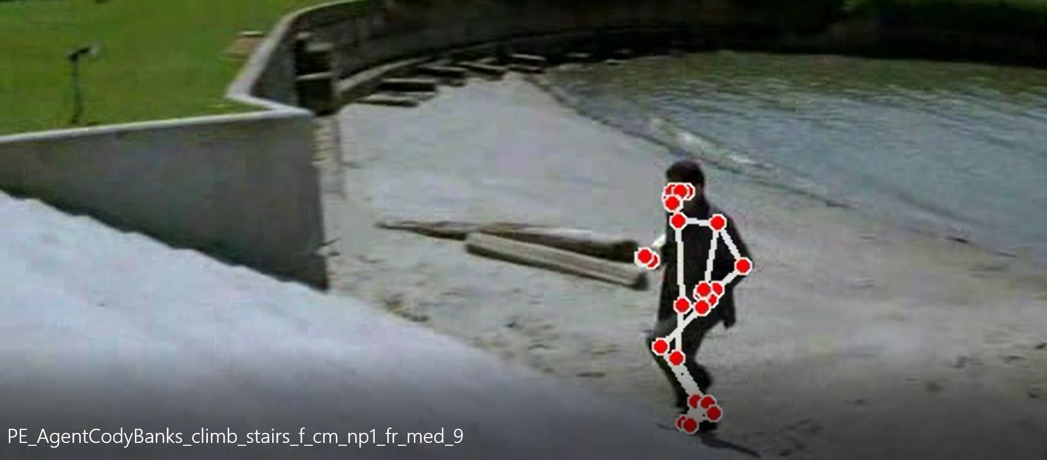
Thought process and ML approach
The distance between the foot (ankles) increases and decrease for each step the actor takes

Slide 15
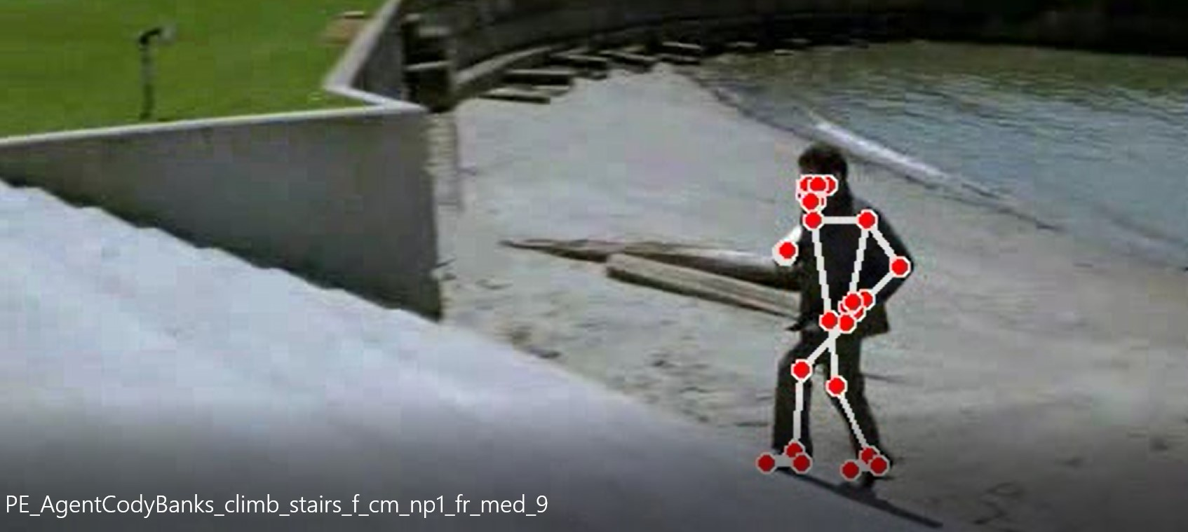
Thought process and ML approach
The distance between the foot (ankles) increases and decrease for each step the actor takes

Slide 16
Thought process and ML approach
Estimating the number of steps climbed by an actor
Research on detecting human and pose estimation – Mediapipe and OpenPose
By assuming height and depth of each stair, and using timestamp of video – Speed can be computed
Where can machine learning fit in ?

Slide 17
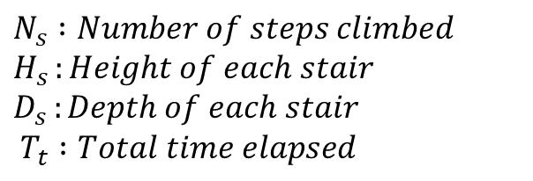

Thought process and ML approach
$S_{m/s}=$ $\frac{N_{s} ×(\sqrt{H_{s}^{2}+D_{s}^{2}})}{T_{t}}$
Eq. : Estimation of speed in m/s
$$N_{s} :Number of steps climbed \\ H_{s }:Height of each stair \\ D_{s }:Depth of each stair \\ T_{t} :Total time elapsed$$

Slide 18
Thought process and ML approach
Estimating the number of steps climbed by an actor
Research on detecting human and pose estimation – Mediapipe and OpenPose
By assuming height and depth of each stair, and timestamp of video – Speed can be computed
Where can machine learning fit in ?

Slide 19
Thought process and ML approach
Optical dense flow - Estimates the motion of objects or pixels in a sequence of images or frames
Eg: Farnebäck Method
A simple machine learning model such as a Random forest could now learn the correlation between the dense optical flow and distance between the feet's.
For every new video – compute optical dense flow vectors (magnitude) and (angle) and the model would predict the speed in steps/seconds!!

Slide 20
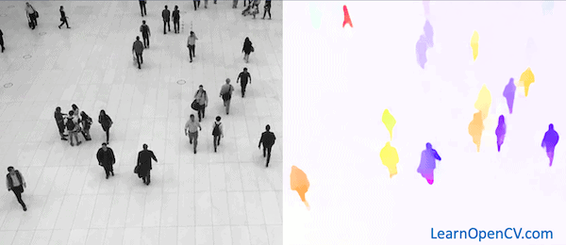
Thought process and ML approach
Motion vector representing of Magnitude and Angle of motion of pixels in a video/images
Fig: Dense flow computation using Open CV

Slide 21
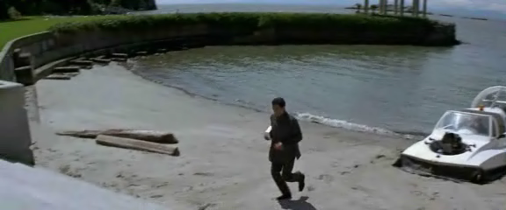
Thought process and ML approach
Vid: Sample video of an actor climbing stairs

Slide 22
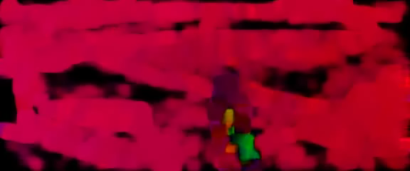
Thought process and ML approach
Vid: Visual representation of Dense flow computation of the same video

Slide 23
Thought process and ML approach
Optical dense flow - Estimates the motion of objects or pixels in a sequence of images or frames
Eg: Farnebäck Method
A simple machine learning model such as a Random forest could now learn the correlation between the dense optical flow and distance between the feet.
For every new video – compute optical dense flow vectors (magnitude) and (angle) and the model would predict the speed in steps/seconds!!

Slide 24
Thought process and ML approach
Optical dense flow - Estimates the motion of objects or pixels in a sequence of images or frames
Eg: Farnebäck Method
A simple machine learning model such as a Random forest could now learn the correlation between the dense optical flow and distance between the feet's.
For every new video – compute optical dense flow vectors (magnitude) and (angle) and the model would predict the speed in steps/seconds!!

Slide 25
Data Preparation
Video were separated into train-test split as provided in the HMDB database
Every video was converted into frames – facilitate pose estimation and dense optical flow computation
A CSV containing file name, dense flow data, distance data and duration was extracted from the video for machine learning
Dense flow data – Convolution of magnitude and angle vectors

Slide 26
Data Preparation
Video were separated into train-test split as provided in the HMDB database
Each video was converted into frames – facilitate pose estimation and dense optical flow computation
A CSV containing file name, dense flow data, distance data and duration was extracted from the video for machine learning
Dense flow data – Convolution of magnitude and angle vectors

Slide 27
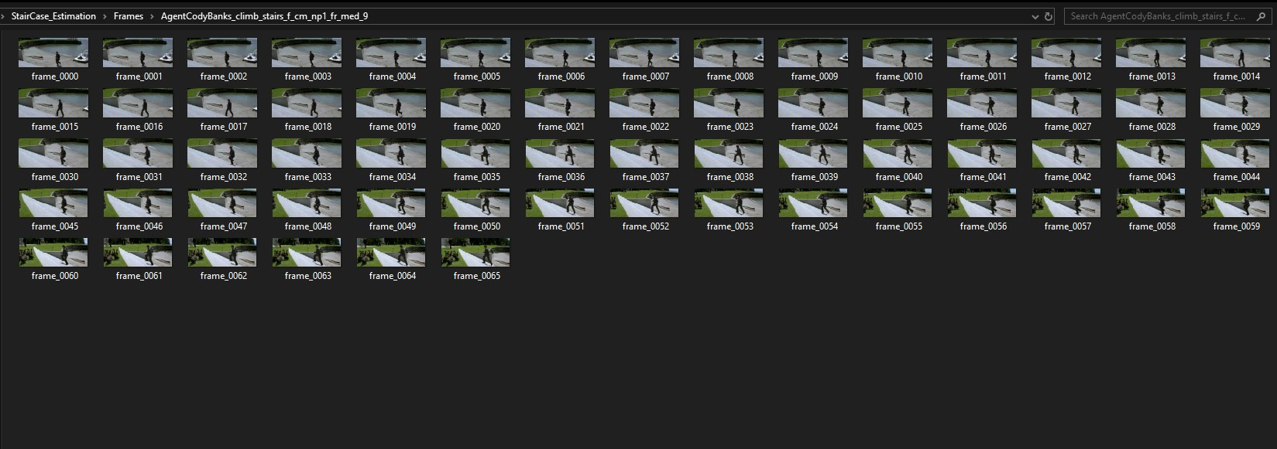
Data Preparation
Fig: Converting each video into frames

Slide 28
Data Preparation
Video were separated into train-test split as provided in the HMDB database
Every video was converted into frames – facilitate pose estimation and dense optical flow computation
A CSV containing file name, dense flow data, distance data and duration was extracted from the videos for machine learning
Dense flow data – Convolution of magnitude and angle vectors

Slide 29
Data Preparation
Video were separated into train-test split as provided in the HMDB database
Every video was converted into frames – facilitate pose estimation and dense optical flow computation
A CSV containing file name, dense flow data, distance data and duration was extracted from the video for machine learning
Dense flow data – Convolution of magnitude and angle vectors

Slide 30
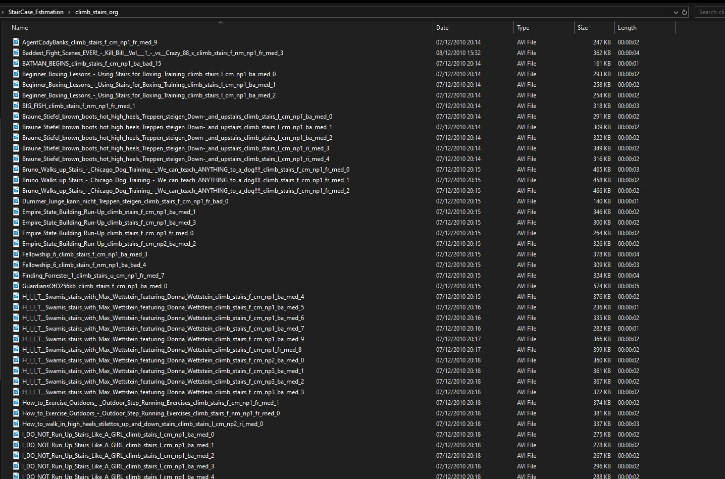
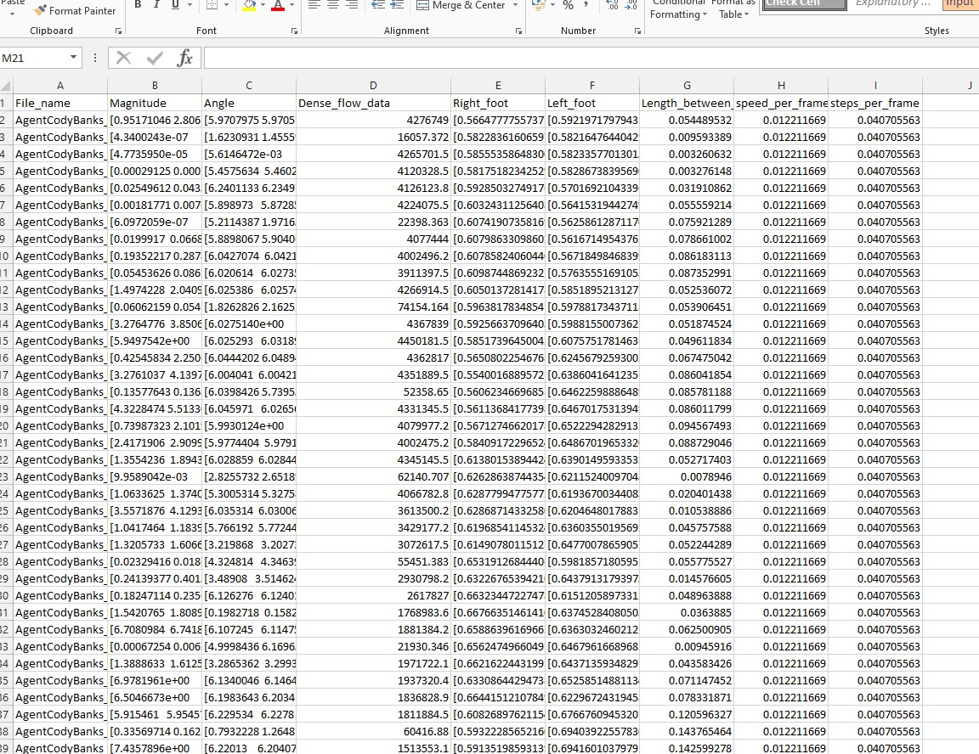
Data preparation
Fig: List of input videos
Fig: CSV encompassing features and targets

Slide 31
Implementation – Code snippets
Used Open-CV to read each video files – process them into frames
For each frame – computed distance between ankles using media pipe pose estimation
How to count number of steps from distance data?
‘Find_peaks’ function from scipy library to locate peaks in 1-D signals
For each frame – computed convoluted values of magnitude and angle vectors

Slide 32
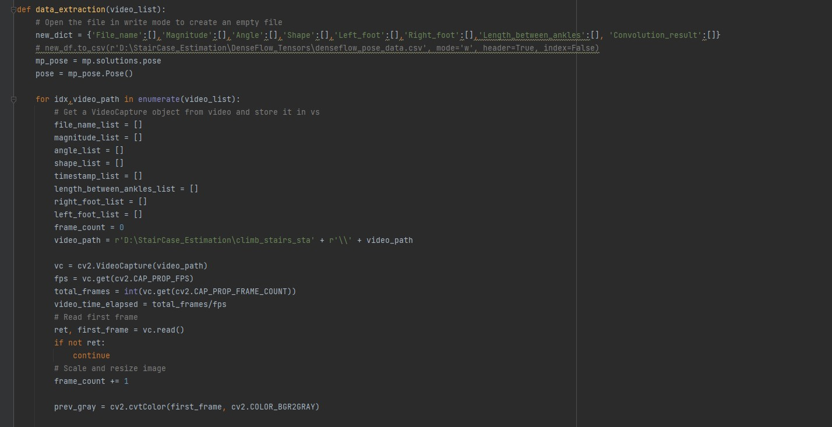
Implementation – Code snippets
Fig: Getting frames for each video

Slide 33
Implementation – Code snippets
Used Open-CV to read each video files – process them into frames
For each frame – computed distance between ankles using media pipe pose estimation
How to count number of steps from distance data?
‘Find_peaks’ function from scipy library to locate peaks in 1-D signals
For each frame – computed convoluted values of magnitude and angle vectors

Slide 34
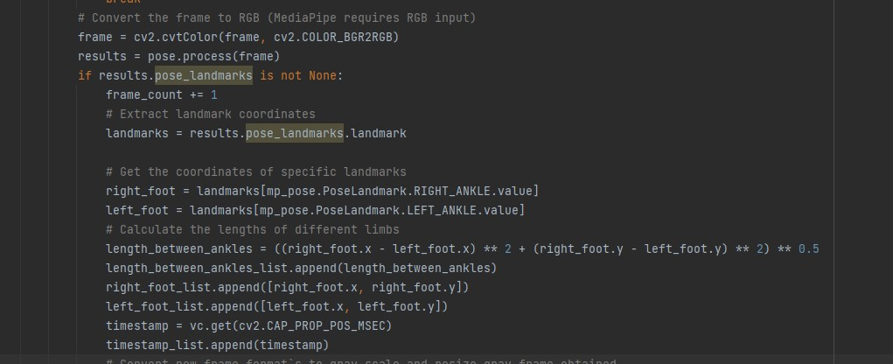
Implementation – Code snippets
Fig: Pose estimation using media pipe library

Slide 35
Implementation – Code snippets
Used Open-CV to read each video files – process them into frames
For each frame – computed distance between ankles using media pipe pose estimation
Estimating number of steps from distance data -
‘Find_peaks’ function from scipy library to locate peaks in 1-D signals
For each frame – computed convoluted values of magnitude and angle vectors

Slide 36
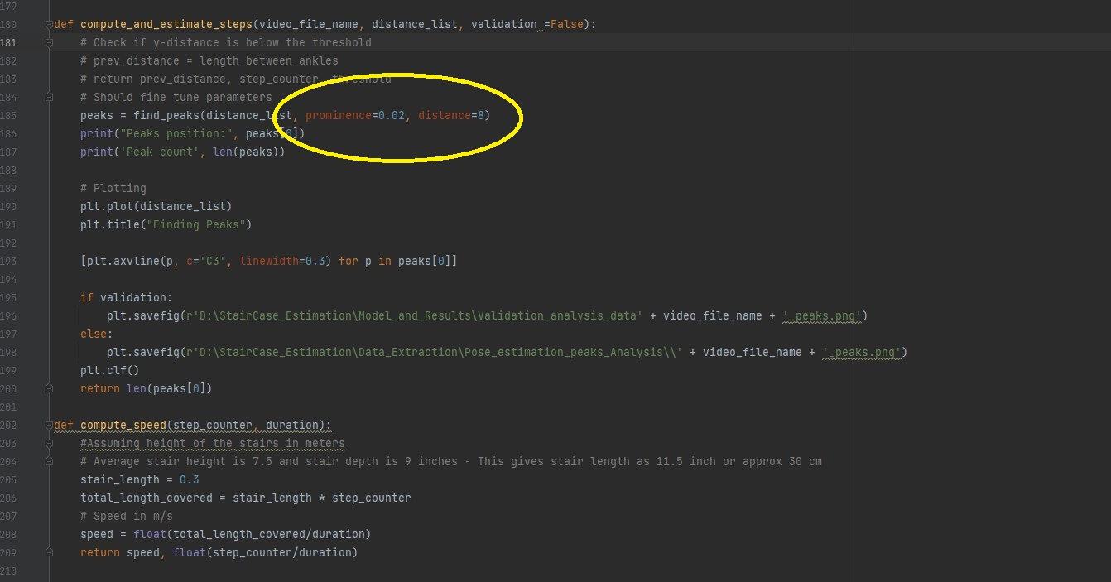
Implementation – Code snippets
Fig: Computing peaks from 1D signals

Slide 37
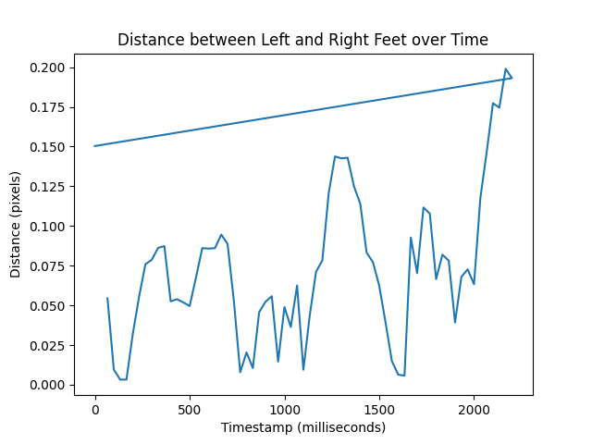
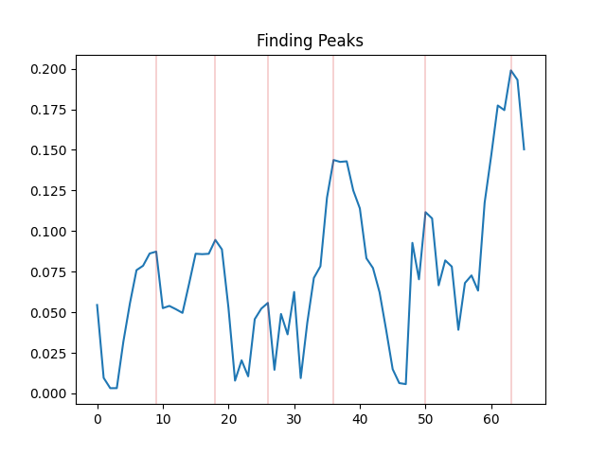
Implementation – Code snippets
Fig: Plot of distance b/w foot w.r.t to time elapsed
Fig: Step counts from 1D time-series using ‘’find_peaks’ function

Slide 38
Implementation – Code snippets
Used Open-CV to read each video files – process them into frames
For each frame – computed distance between ankles using media pipe pose estimation
How to count number of steps from distance data?
‘Find_peaks’ function from scipy library to locate peaks in 1-D signals
For each frame – computed dense optical flow and convoluted values of magnitude and angle vectors

Slide 39
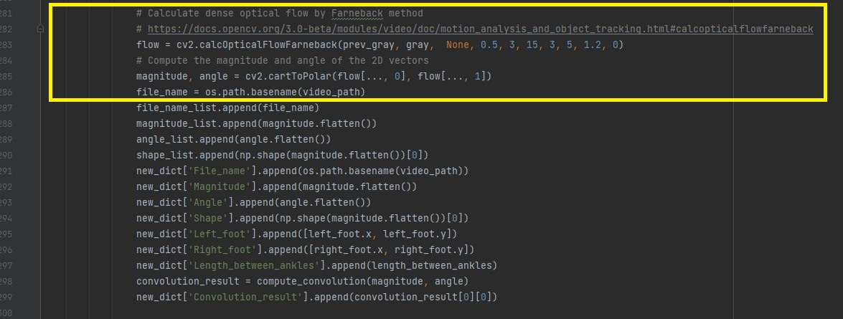
Implementation – Code snippets
Fig: Dense Optical flow computation using Farneback algorithm

Slide 40
Implementation – Code snippets
Machine learning – using a random forest regressor
With hyper-parameter tuning and bootstrapping using GridSearchCV
param_grid = {
'bootstrap': [True],
'max_depth': [80, 90, 100, 110],
'max_features': [2, 3],
'min_samples_leaf': [3, 4, 5],
'min_samples_split': [8, 10, 12],
'n_estimators': [100, 200, 300, 1000]
}
Testing pipeline – Inputs a video , Computes dense flow features, predicts speed in steps/second

Slide 41
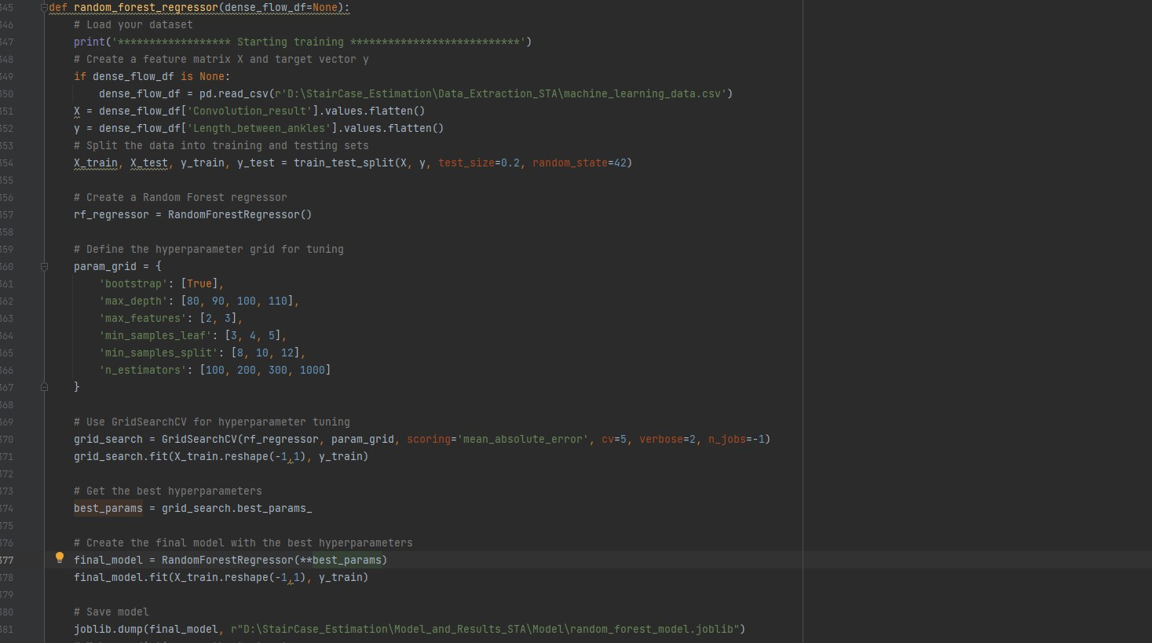
Implementation – Code snippets
Fig: Machine learning using random forest

Slide 42
Implementation – Code snippets
Machine learning – using a random forest regressor
With hyper-parameter tuning and bootstrapping using GridSearchCV
Testing pipeline – Inputs a video , Computes dense flow features, predicts speed in steps/second

Slide 43
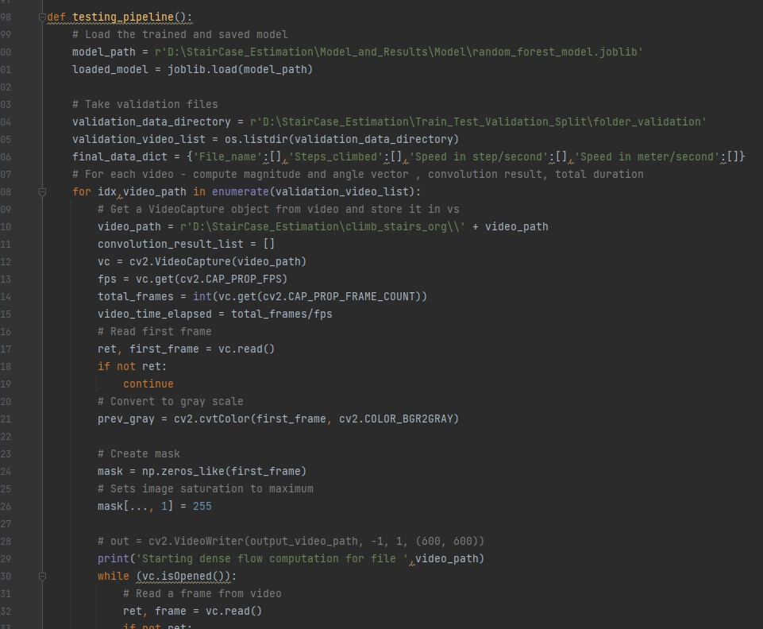
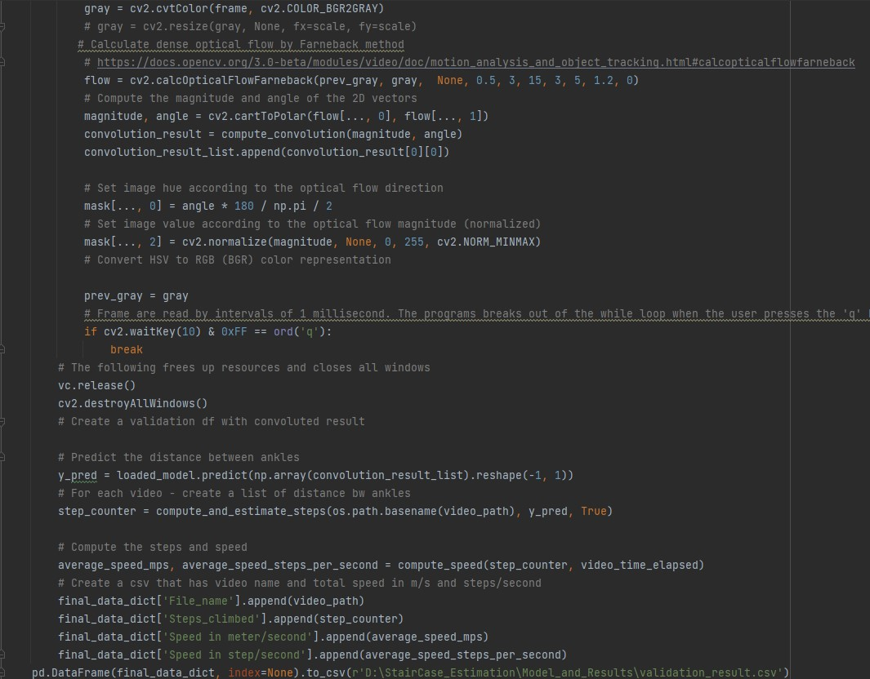
Implementation – Code snippets
Fig: Testing pipeline 1.1
Fig: Testing pipeline 1.2

Slide 44
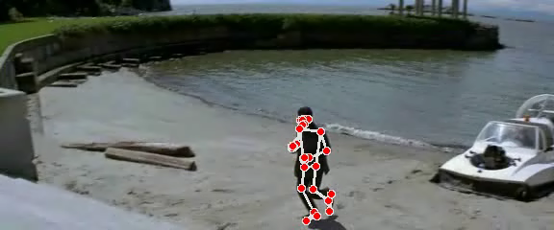
Results
Fig: Pose estimated video of an actor climbing stairs

Slide 45
Results
Fig: Plot of distance b/w foot w.r.t to time elapsed
Fig: Step counts from 1D time-series using ‘’find_peaks’ function

Slide 46
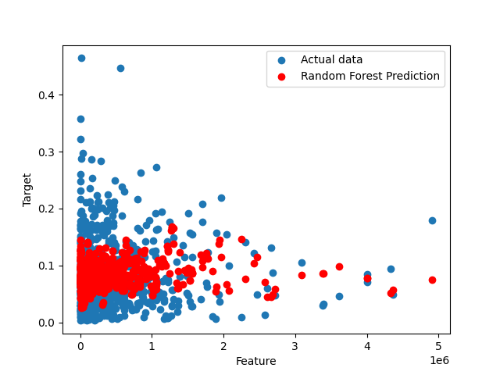
Results
Prediction Analysis and hyper-parameters
Best parameters: {'bootstrap': True, 'max_depth': 90, 'max_features': 3, 'min_samples_leaf': 5, 'min_samples_split': 12, 'n_estimators': 300}
Mean Absolute Error: 0.04536
Mean Squared Error: 0.003603
Mean Absolute Percentage Error: 1.19
Fig: Actual vs Predicted data after training

Slide 47
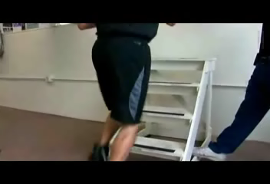
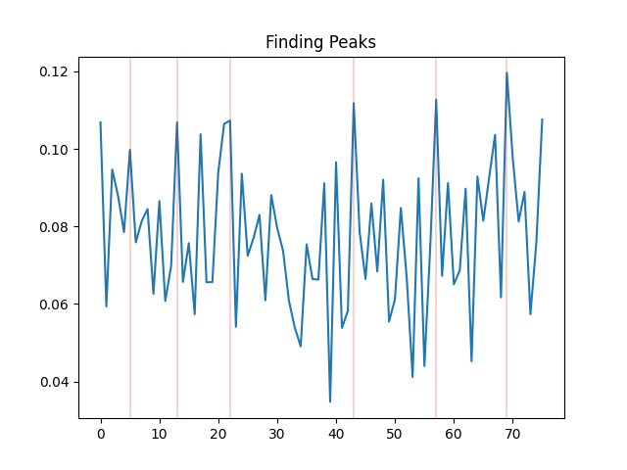
Results
Predicted Speed : 2.307 steps/second or 0.692 metre/second
Fig: Test video of actor climbing stairs
Fig: Predicted distance data – 6 steps can be counted

Slide 48
Limitations and Future Works
Accuracy comparison with different models - RNN
Heavily depended on pose estimation – OpenPose may provide better accuracy
Extracting more features of the staircase using 3D point cloud
Such as height, depth and angle of the staircase
Extracting more features of the actor
Such as age, weight, height, gender
Actor taking multiple steps at a time - Solution?
Custom dataset with high quality videos

Slide 49
References
Kuehne, H., Jhuang, H., Garrote, E., Poggio, T. and Serre, T. (n.d.). HMDB: A Large Video Database for Human Motion Recognition. [online] Available at: http://serre-lab.clps.brown.edu/wp-content/uploads/2012/08/Kuehne_etal_iccv11.pdf [Accessed 19 Jan. 2024].
‌Bazarevsky, V., Grishchenko, I., Raveendran, K., Zhu, T., Zhang, F. and Grundmann, M. (n.d.). BlazePose: On-device Real-time Body Pose tracking. [online] Available at: https://arxiv.org/pdf/2006.10204.pdf.
Gehrig, M., Millhäusler, M., Gehrig, D. and Scaramuzza, D. (n.d.). E-RAFT: Dense Optical Flow from Event Cameras Multimedia Material. [online] Available at: https://arxiv.org/pdf/2108.10552.pdf [Accessed 19 Jan. 2024].
‌Guo, Y., Wang, H., Hu, Q., Liu, H., Liu, L. and Bennamoun, M. (n.d.). Deep Learning for 3D Point Clouds: A Survey. [online] Available at: https://arxiv.org/pdf/1912.12033.pdf
‌Chéron, G., Laptev, I. and Schmid, C. (n.d.). P-CNN: Pose-based CNN Features for Action Recognition. [online] Available at: https://arxiv.org/pdf/1506.03607.pdf [Accessed 19 Jan. 2024].
Delin, Mattias & Norén, Johan & Ronchi, Enrico & Kuklane, Kalev & Halder, Amitava & Fridolf, Karl. (2016). Ascending stair evacuation: walking speed as a function of height. Fire and Materials. 41. 514-534. 10.1002/fam.2410.

Slide 50
Thank You

